Slide 1
Insurance Premium Prediction

Slide 2
Objective :
to give people an estimate of how much they need based on
their individual health situation. So that they can choose right insurance
policies for there health. This can assist a person in concentrating on the
health side of insurance policy.

Slide 3
Benefits :
This project will help to get to know about helath insurance premium
This will also help to know status of health and to choose right insurance
For your health

Slide 4
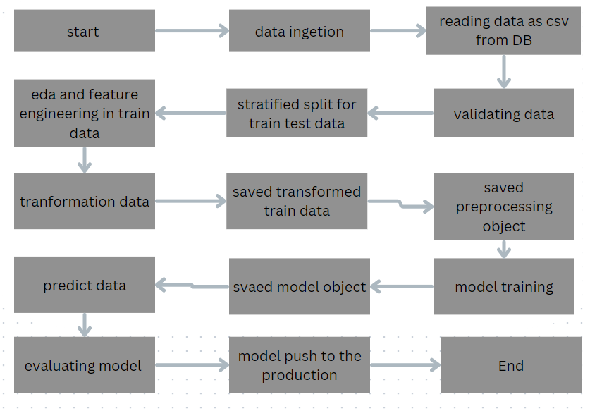
Architecture

Slide 5
Data ingestion and validation
In data ingestion stage we are reading data from Cassandra database.
After downloading data as csv file we will create data validation stage at there we will validate data as per our schema .
Schema check and no of column check: In validation of data we will check no of columns and datatype of columns also we both are good then we will go ahead ,if condition is not fullfill we will create exception
for that

Slide 6
Data transformer
In data transformer stage we will first check null value if there is null value we will handle the null values if not will move
In the dataset there is categorical as well as numerical variable for that we are using one hot encoding technique to handle all categorical variable.
for categorical variable and numerical variable we want all the data should be in proper scale for that we are also using scaling data technique that is standard scaler technique.
Transformed data we will save .npz formate(array form to train the model)

Slide 7
Model training
Data Preprocessing
Performing EDA to get insight of data like identifying distribution , outliers ,trend among data etc.
Check for null values in the columns. If present impute the null values.
Encode the categorical values with numeric values.
Perform Standard Scalar to scale down the values.

Slide 8
Model selection
We are perform all the model which is provide in model.yaml
Find the best model first then check accuracy then try to do some hyper parameter tuning
And try to find out best model with the best parameter for our production
Prediction : The testing files are shared in the batches through grid search cv.
we perform data preprocessing technique and then try to predict through ui .

Slide 9
Q & A:
What’s the source of data ?
the source of data provided by ineuron team .
What was the type of data?
there is both kind of data which is categorical as well as numerical.
What’s the complete flow you followed in this Project?
reffered to the 4th slide for better understanding
How logs are managed?
each and evry module or file managed by logs by there specific name
For understandings

Slide 10
Q.&A.
What techniques were you using for data pre-processing?
Removing unwanted attributes
Visualizing relation of independent variables with each other and output variables
Checking and changing Distribution of continuous values
Removing outliers
Cleaning data and imputing if null values are present.
Converting categorical data into numeric values.
Scaling the data

Slide 12
Q.A. :
What are the different stages of deployment?
We will create docker image and then we will push our code to the github and github action will provide a facility to push continue code to any deploy stage here we are sending code to aws .

Slide 13
The END
Thankyou for watching

